Slide 1
Neural Networks:
Machine Learning Models
Understanding Deep Learning Fundamentals

Slide 2
TOPICS TO BE COVERED -
Introduction to Neural Networks
How Neural Networks Work
Types of Neural Networks
Training Process
Activation Functions
Deep Learning vs Traditional ML
Applications & Use Cases
Advantages & Limitations
Popular Frameworks
Future of Neural Networks

Slide 3
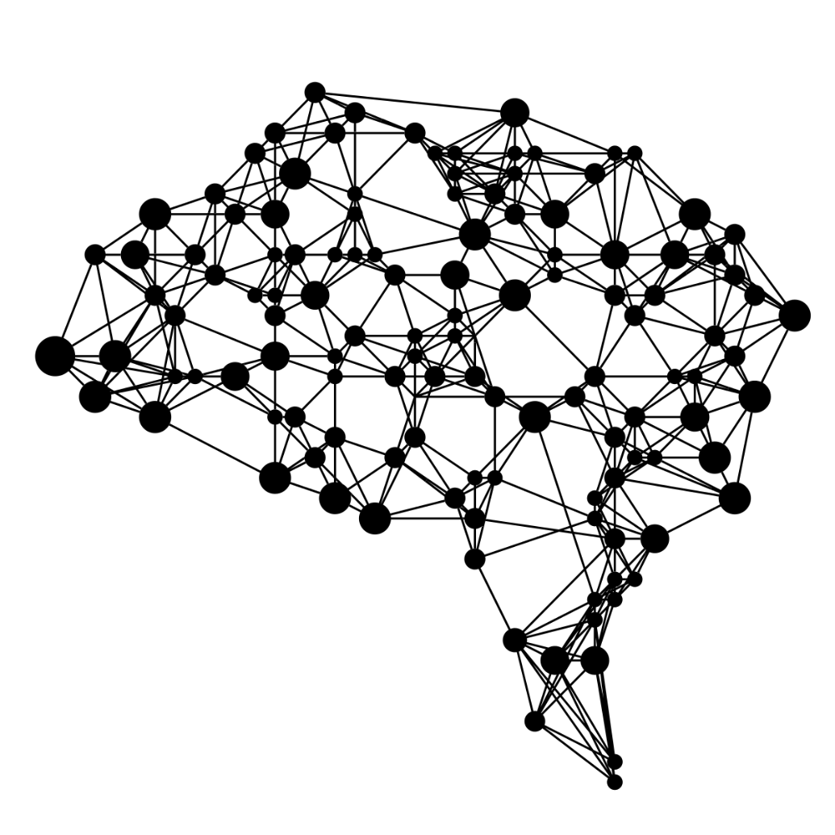
NEURAL NETWORKS
Neural Networks are powerful computational models inspired by the complex structure of the human brain. They are designed to mimic how biological neurons process information.
At their core, neural networks consist of interconnected "nodes" (artificial neurons) that work together to learn patterns and make decisions from data, forming the backbone of modern AI.

Slide 4
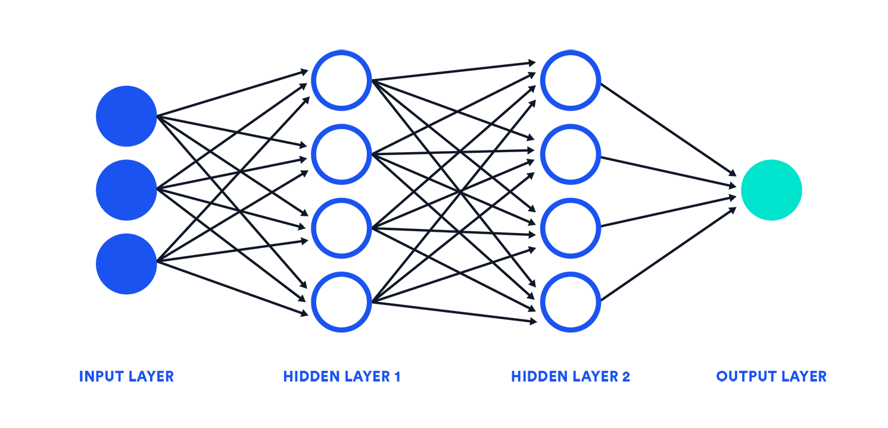
HOW NEURAL NETWORKS WORK
A neural network is organized into distinct layers: an input layer takes in the raw data, one or more hidden layers perform complex computations, and an output layer delivers the network's final prediction or classification.
Information flows unidirectionally through these layers. Each connection between neurons carries a weight, indicating its importance, and each neuron has a bias. These values are adjusted during training to refine the network's processing. Neurons aggregate their weighted inputs, and if this sum surpasses an activation threshold, they fire, transmitting a signal to the subsequent layer.

Slide 5




TYPES OF NEURAL NETWORKS
Neural networks come in various architectures, each optimized for different types of tasks and data structures. Here are some of the most common:
Feedforward Neural Networks (FNNs)
Convolutional Neural Networks (CNNs)
The simplest type, information flows in one direction from input to output, without cycles. Used for classification and regression tasks.
Specialized for processing grid-like data such as images. They use convolutional layers to automatically and adaptively learn spatial hierarchies of features.
Recurrent Neural Networks (RNNs)
Long Short-Term Memory (LSTMs)
Designed to handle sequential data, like time series or natural language. They have internal memory, allowing them to use previous outputs as inputs.
A type of RNN capable of learning long-term dependencies. They address the vanishing gradient problem in traditional RNNs, making them ideal for complex sequences.

Slide 6
TRAINING PROCCESS
Training a neural network is an iterative process where the network learns from data by continuously adjusting its internal parameters. This cycle involves several key steps:
Backpropagation
  The calculated loss is propagated backward through the network to determine how much each weight contributed to the error.
Gradient Descent
  Weights and biases are adjusted in the direction that minimizes the loss, effectively teaching the network to make better predictions.
  Through many repetitions of this cycle with large datasets, the neural network refines its internal parameters, enabling it to learn complex patterns and perform tasks like classification or prediction with high accuracy.
Forward Propagation
  Input data travels through the network, layer by layer, until it produces an output prediction.
Loss Calculation
  The network's prediction is compared to the actual target value, and a "loss" or "error" is calculated.

Slide 7
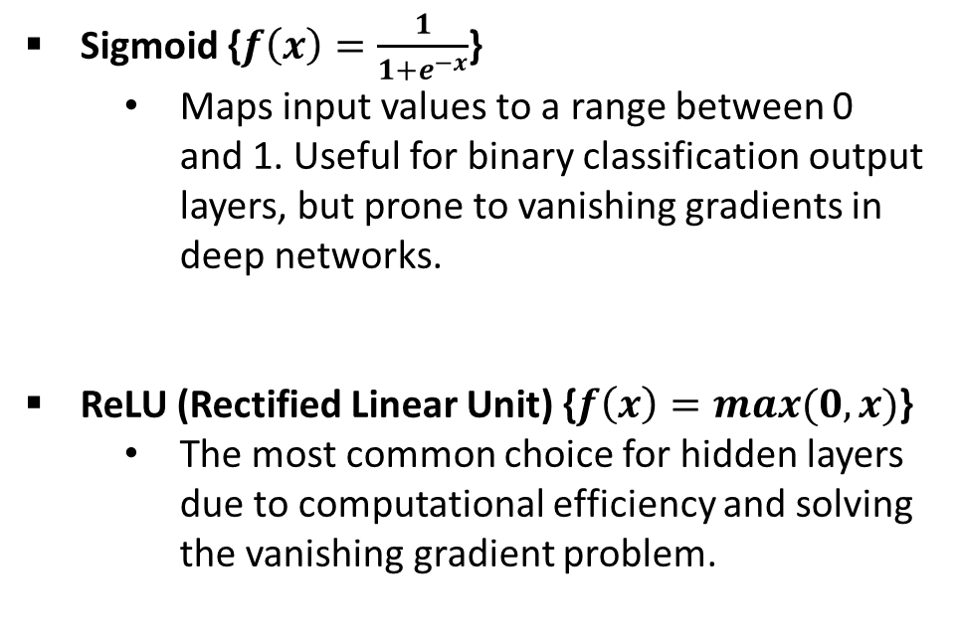
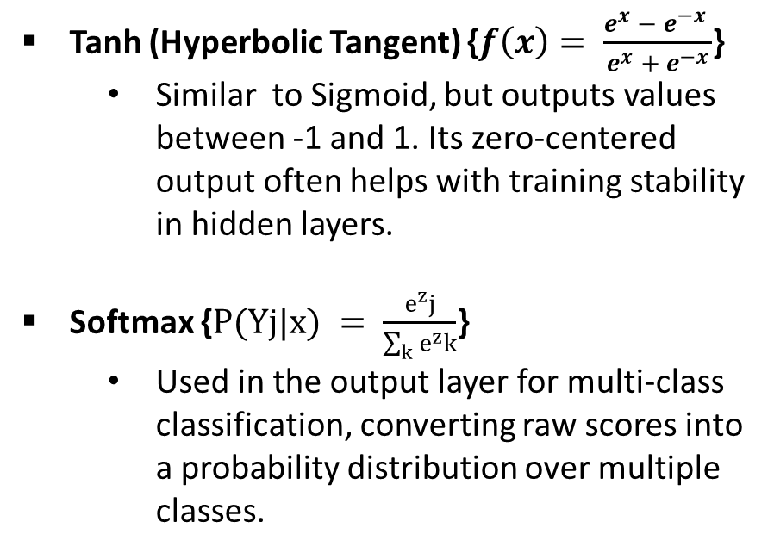
ACTIVATION FUNCTIONS
Activation functions introduce non-linearity into neural networks, allowing them to learn complex patterns and make sophisticated decisions beyond simple linear relationships. Without them, a neural network, no matter how deep, would behave like a single-layer perceptron.
Tanh (Hyperbolic Tangent) {$f\left(x\right)= \frac{e^{x} −{ e}^{−x} }{e^{x} + e^{−x}}$}
  Similar to Sigmoid, but outputs values between -1 and 1. Its zero-centered output often helps with training stability in hidden layers.
Softmax {$P(Yj|x) = \frac{e^{z}j}{\sum_{k}{e^{z}k}}$}
  Used in the output layer for multi-class classification, converting raw scores into a probability distribution over multiple classes.
Sigmoid {$f\left(x\right)=\frac{1}{1+e^{−x}}$}
  Maps input values to a range between 0 and 1. Useful for binary classification output layers, but prone to vanishing gradients in deep networks.
ReLU (Rectified Linear Unit) {$f\left(x\right)=max(0,x)$}
  The most common choice for hidden layers due to computational efficiency and solving the vanishing gradient problem.

Slide 8
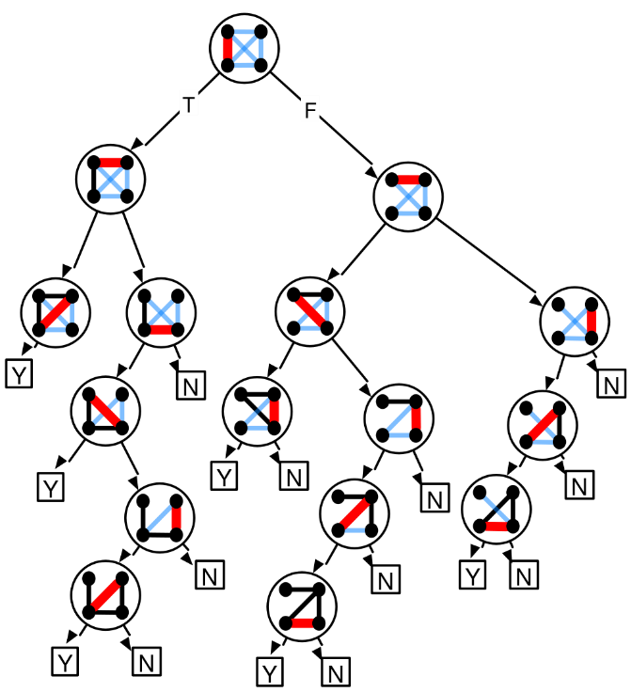
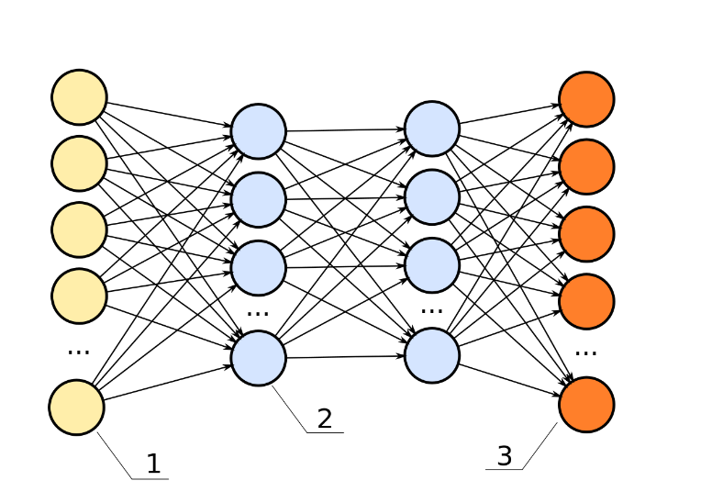
NEURAL NETWORKS VS
TRADITION MACHINE LEARNING
While both deep learning (neural networks) and traditional machine learning aim to learn from data, they differ significantly in their approaches, capabilities, and ideal use cases. Understanding these distinctions is crucial for selecting the right model for a given problem.
Feature Extraction | Automatic, learns from raw data | Manual, human-engineered features
Data Requirements | Requires large datasets | Effective with smaller datasets
Interpretability | "Black box," hard to explain | More transparent and interpretable
Performance | Scales well, high accuracy on complex tasks | Performance often plateaus, struggles with highly complex data
DECISION TREE
NEURAL NETWORK

Slide 9






APPLICATIONS & USE CASES
Neural networks are at the forefront of innovation, powering a diverse range of applications across industries.
IMAGE RECOGNITION
Natural Language Processing
Enabling computers to identify and classify objects, faces, and scenes in images and videos, crucial for security, medical imaging, and retail.
Facilitating human-computer interaction through sentiment analysis, machine translation, chatbots, and voice assistants.
AUTONOMOUS VEHICLES
MEDICAL DIAGNOSIS
Driving perception, decision-making, and control systems in self-driving cars, making transportation safer and more efficient.
Assisting healthcare professionals in detecting diseases like cancer, analyzing medical images, and predicting patient outcomes.
RECOMMENDATION SYSTEMS
FINANCIAL FRAUD DETECTION
Personalizing user experiences on platforms like Netflix, Amazon, and Spotify by suggesting relevant products or content.
Identifying unusual patterns and anomalies in financial transactions to prevent fraud and protect sensitive data.

Slide 10
ADVANTAGES & LIMITATIONS
Neural networks offer powerful capabilities but also come with significant challenges that need to be considered for their effective deployment.
ADVANTAGES
  Exceptional Pattern: Recognition: Excel at identifying complex, non-linear patterns in vast datasets.
  Scalability with Data: Performance generally improves with more data and increased computational power.
  High Versatility: Applicable across diverse domains, including image processing, natural language, and predictive analytics.
  Automatic Feature Extraction: Neural networks can automatically learn and extract relevant features from raw data.
LIMITATIONS
  Intensive Data Requirements: Demand massive, high-quality datasets for effective training and generalization.
  High Computational Cost: Training and deployment can be resource-intensive, requiring specialized hardware (GPUs).
  "Black Box" Interpretability: Decisions can be difficult to understand or explain, hindering trust and debugging.
  Risk of Overfitting: Can memorize training data too well, leading to poor performance on unseen data.

Slide 11
POPULAR FRAMEWORKS
The landscape of deep learning is supported by powerful open-source frameworks that simplify the development, training, and deployment of neural networks. These tools empower developers and researchers to build sophisticated AI models.
TENSORFLOW (GOOGLE)
  A comprehensive open-source platform for machine learning, widely adopted for production-scale deep learning, distributed training, and deployment on various devices.
PYTORCH (META)
  Known for its Pythonic interface, dynamic computation graph, and ease of debugging, making it a favorite for academic research and rapid prototyping, especially in computer vision and NLP.
KERAS
  A user-friendly, high-level neural network API designed for fast experimentation. It runs on top of TensorFlow, simplifying model development and prototyping for beginners and experts alike.
SCIKIT-LEARN
  While primarily a traditional machine learning library, Scikit-learn is often integrated with deep learning workflows for data preprocessing, classical ML tasks, and model evaluation due to its robust suite of algorithms.

Slide 12






NEURAL NETWORK PERFORMANCE METRICS
Understanding how to evaluate neural network performance is crucial for developing effective and reliable AI models. These metrics provide insight into various aspects of a model's predictive power, guiding model selection and optimization.
ACCURACY
PRECISION
RECALL
The proportion of correctly classified instances (true positives and true negatives) out of the total number of instances. It's a general measure of correctness.
Measures the proportion of true positive predictions among all positive predictions made by the model. It focuses on the quality of positive predictions.
Measures the proportion of true positive predictions among all actual positive cases in the dataset. It focuses on the model's ability to find all positive instances.
F1-SCORE
LOSS FUNCTIONS
CONFUSION MATRIX
The harmonic mean of Precision and Recall. It provides a single metric that balances both measures, especially useful when class distribution is uneven.
Quantifies the error between predicted outputs and actual target values during training. Common examples include Mean Squared Error (MSE) for regression and Cross-Entropy for classification.
A table summarizing the performance of a classification model, visually breaking down predictions into true positives, true negatives, false positives, and false negatives.

Slide 13





FUTURE OF NEURAL NETWORKS
The field of neural networks is constantly evolving, with new research and advancements shaping the future of AI. These emerging trends promise to unlock unprecedented capabilities and address complex global challenges.
TRANSFORMER ARCHITECTURES
GENERATIVE AI
NEUROMORPHIC COMPUTING
Revolutionizing NLP and vision with self-attention, allowing models to understand context over long sequences efficiently.
Creating realistic images, text, and code through models like GANs and Diffusion, pushing creative boundaries and automating content.
Developing hardware that mimics the human brain's structure for vastly more energy-efficient and faster AI processing.
QUANTUM NEURAL NETWORKS
ETHICAL AI CONSIDERATIONS
Merging quantum mechanics with NNs to solve problems intractable for classical computers, leveraging superposition.
Focusing on fairness, transparency, and accountability to mitigate bias, ensure privacy, and guide AI development responsibly.

Slide 14
KEY TAKEAWAYS
BRAIN-INSPIRED POWER
RESOURCE DEMANDS
ARCHITECTURE DIVERSITY
Neural networks excel at pattern recognition and complex decision-making, mimicking biological brains.
Training effective models requires vast datasets and significant computational resources (GPUs, TPUs).
Specialized network designs (CNNs, RNNs, Transformers) are optimized for various tasks and data types.
CRUCIAL EVALUATION
RAPID EVOLUTION
Robust metrics (Accuracy, Precision, Recall, F1-Score) are essential for reliable model assessment.
The field constantly advances with new architectures, generative AI, and ethical considerations shaping its future.

Slide 15
THANKYOU
PRESENTED BY –
AAYAN SHAHID - 2400101557
TASMIYA SALIM - 2400103213
TANZEELA BANO - 2400100722
TAALIB RAHMAN - 2400102223
MOHAMMAD FAISAL - 2400103610
MAURICE RAJ - 240010052

